Slide 1
Guidelines
House Rules:
Come in on time
Participate in the discussion and activities
Complete the code exercises
Submit all deliverables
Promote CORBIS

Slide 2
PDC Training Policies and Guidelines
Course completion requires attendance at least 80% of the time. Attendance must be signed before and after the training.
As appropriate, participants are required to meet the standards to pass the course which includes remediation as necessary. This is a key input to employee permanency (e.g. Bootcamps).
Per Policy 57 (Acceptable Use of Information, Devices and Technology) course materials and outputs may NOT be disseminated outside Accenture thru such actions as:
Posting in the internet thru social media, blogs, forums, etc.
Forwarding to non-Accenture emails including personal mails
Storing in removable devices such as hard drives, USB, CDs, etc.
Violation of Policy 57 will be sanctioned according to Accenture Code of Discipline.
As appropriate, course outputs MUST be submitted.
Any form of cheating will be handled according to the Accenture Code of Discipline.
Participants should use the appropriate WBS to charge time and expenses (as applicable) related to training. As necessary, it must be ensured that training hours are recovered to help meet chargeability targets.

Slide 3
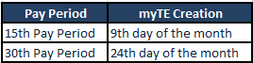
HR Reminders
My Time and Expense (MyTE)
myTE creation
WBS to use
myTE Approver
honeylee.s.escote | ryan.c.g.gonzales | salvacion.l.biason
Ariba | IM/DDA | DCS Non-ISIS
Peoplesoft | Hostcentric | Java, C++
Siebel | QM | JDE
Software as a Service | SAP | Mobility
Testing | Tech Arch | Oracle
 |  | PPSM/ Industry
william.d.cauguiran
All Cebu Bench Employees
Note:
ASE’s < 6 months – in case the bootcamp attendee reports to bench due to training cancellation or postponement, please still use I8635007
Lateral on bench/Non ASE/ASE > 6 months – please use bench WBS - ARDM001 (Manila) / ARDMB001 (Cebu) if you are attending classroom training or bootcamp.
MyTE Reviewer – main Instructor/ Faculty per bootcamp
Notes:
WBS provided are specific to Center Bench ITP.
Please update where necessary.

Slide 4
HR Reminders
Leaves and Holidays
Category | Availment | Notification
Vacation Leave | 1.25 days per month accrual (total of 15 days per year) | Employees are required to follow the vacation leave application, scheduling and approval process. Subject to business exigencies, applications for VL may be mandated, re-scheduled, or disapproved. 1 - 2 weeks lead time is required for vacation leave.
Sick Leave | 1.08 days per month accrual (total of 13 days per year) | Employees must notify his Instructor/ Lead of absence due to sickness or injury through AbsenceCare hotlines. (02) 548 9100 (PLDT) (02) 717 3500 (Globe) (02) 909 2273 (Globe) Cebu (032) 265 5000 Employees should not rely on messages left with co-workers to provide notice. Inasmuch as it is reasonably possible, notification should be at least two (2) hours before the employee’s work shift of each sick day to be taken.
Elective Holiday | 2 elective holidays may be chosen as non-working holiday, and the rest are expected to be worked | Employee needs to notify Instructor/ Lead if he will take the Elective Holiday or will be reporting to work on that day. Unworked EH more than 2 days will be charged to VL/SL if valid
Note:
New joiners are entitled to avail pro-rated VL and SL for the fiscal year (accrual X number months from hire date)
If VL/ SL is not approved prior taking the leave, this may be considered as Absence Without Official Leave and will be processed accordingly
Leave approver during bootcamp = Instructor/ Assigned faculty
Notes:
Sick leave may be disapproved if employee failed to call Absencecare for advance notification, or to provide medical certificate as required.

Slide 5
HR Reminders
Attendance Guidelines
Provision | Details | Sanction
B. Attendance Item 1 | Failure to comply with the prescribed procedure in notifying the Company of his/her absence or tardiness. | Minor
B. Attendance Item 2 | Failure to report to work on time or comply with project/ deal specific procedures on attendance: a) Failure to report for work on time resulting in either an accumulated or single occasion of tardiness of 45 minutes or every 3 instances of tardiness, whichever comes first, within the same calendar month shall be considered one infraction. | Minor
 | b) 18 accumulated instances of tardiness within a rolling 12 month period will be treated as gross and habitual neglect of duties. | Grave
B. Attendance Item 3 | Any absence without authorized leave. | Serious to Grave
Note:
Failure to call AbsenceCare for SL’s may be considered unapproved absences, and employee will be given coaching on top of charging days to Unpaid Leave
VL’s availed but were not requested and approved at least 2 weeks may be considered unauthorized leave/ absences as well
At least 3days of unauthorized absence will warrant Absence Without Authorized Leave (AWOL), where employees may lose access to Accenture accounts and salary may be put on hold on top of discipline process
Leads have the prerogative to confirm reason for leaves, request for supporting documents as needed, and the authority to disapprove leave applications if deemed not valid
Notes:
These provisions are in our Code of Discipline (Accenture Discipline Policy 0093)

Slide 6
HR Reminders
Promoting Integrity in the Bootcamp/ Training
Provision | Details | Sanction
C. Professional Conduct Item 7 | Any form of dishonesty, including but not limited to: a) Misrepresentation of qualifications; b) Misrepresentation of self as an Accenture authorized representative; c) Falsification of Company records or documents; d) Cheating on time or work output records; e) Providing any false or misleading information to any Company employee, investigation or inquiry. | Serious to Grave
F. Information Security Item 3 | Revealing or disclosing, whether intentionally or unintentionally or negligently, to any unauthorized persons confidential information of Accenture and/or its clients, including but not limited to: a) Proprietary information; b) Operational or transactional information; c) Trade secrets; d) Clients' and employees' personal information; e) Information related to administrative proceedings; f) All other information described, considered or treated as confidential. | Serious to Grave
F. Information Security Item 3 | Unauthorized accessing, downloading, duplication, dealing with, storing or possession of confidential Company or client information, or an attempt to do any of the aforementioned acts such as but not limited to: a) Attempt to store Company information on personal storage devices; b) Storing client information on local drives on PCs. | Serious to Grave
Notes:
These provisions are in our Code of Discipline (Accenture Discipline Policy 0093)

Slide 7
HR Reminders
Sanction per Misconduct Level
Misconduct Level | Table of Sanctions
Serious | 1st Act of misconduct: CAA with Warning up to Final Written Warning 2nd Act of misconduct: Final Written Warning up to Termination of Employment 3rd Act of misconduct: Termination of Employment
Grave | 1st Act of misconduct: Termination of Employment
SAMPLE scenario from Bootcamp
Copying of, comparing, or giving/ sharing answers during conduct of individual activities, such as: quizzes, hands-on activity, take home individual assignment, major examination/ assessment, remedial exam, etc.
Discussion during conduct of individual activities, such as: quizzes, hands-on activity, major examination/ assessment, remedial exam, etc.
Viewing, downloading, distribution, sharing, and/or use of reference materials, answer keys, or any material that may impact scores during individual and group activity, major examination/ assessment, remedial exam, etc.
Notes:
Instructor may provide specific scenario applicable to the bootcamp, as there may be variations / specifications unique to each run of training.
Cheating may include (select scenario which is appropriate to the bootcamp requirements, as there may be requirements that may be considered cheating in other sessions/ training):
- Copying of, comparing, or giving/ sharing answers during conduct of individual activities, such as: quizzes, hands-on activity, take home individual assignment, major examination/ assessment, remedial exam, etc.
- Discussion during conduct of individual activities, such as: quizzes, hands-on activity, major examination/ assessment, remedial exam, etc.
- Viewing, downloading, distribution, sharing, and/or use of reference materials, answer keys, or any material that may impact scores during individual and group activity, major examination/ assessment, remedial exam, etc.

Slide 8


Slide 9
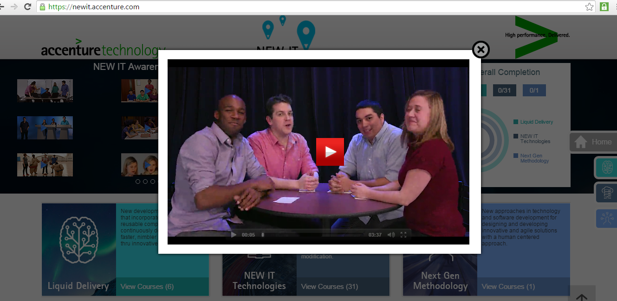

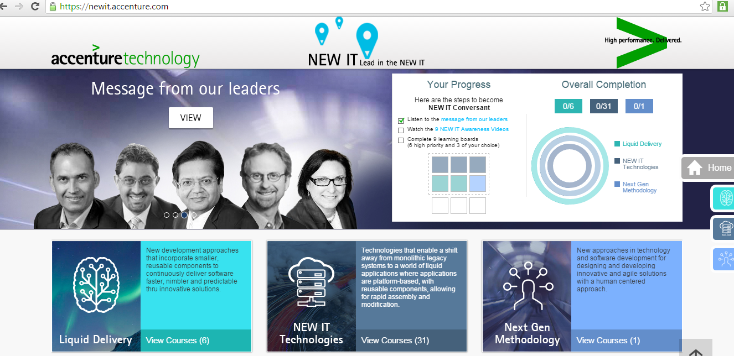
Introducing…..do YOU speak NEW IT?
https://newit.accenture.com
Note:
PRIORITY: Employees are expected to take New IT courses/ trainings (https://newit.accenture.com/)
Aside from Mandatory Trainings as indicated in NJO kit + MyLearning, take available New IT courses to complete your 9hours work or while staying in Bootcamp venue prior official roll-in date to Bench.
Completion dashboard will be part of Bench requirement as well
Notes:
Here is some of the imagery associated with NEW IT. We have developed a comprehensive learning program and website all designed to help you learn about NEW IT. There are over 40 learning boards on NEW IT topics. Each learning board is about an hour worth of content – all self study, at your own pace. Available on tablets and mobiles. Videos on each learning board vary from 1 minutes to 30 minutes.

Slide 10
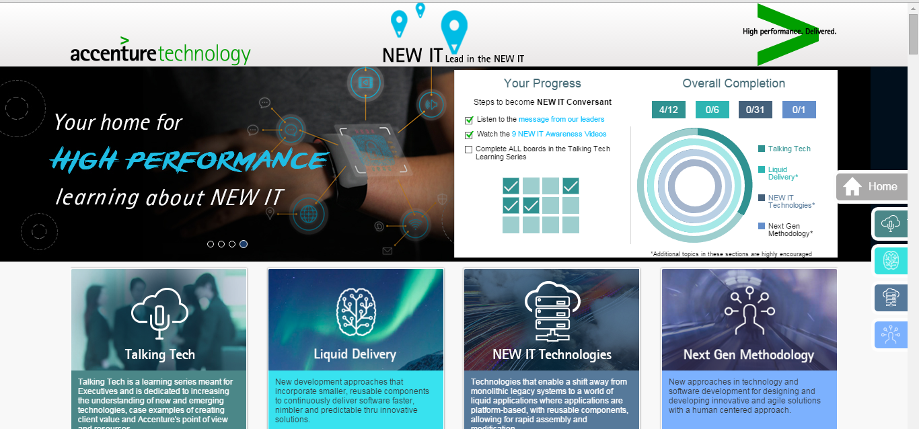
How to get NEW IT Conversant
https://newit.accenture.com
Executives - CLs7-1
Complete the Talking Tech Learning Series.
9 Talking Tech boards to be considered NEW IT Conversant; however, all 12 Talking Tech boards will be expected of our executives.
Currently 8 boards available, 1 more available by mid May, last 3 in Q4.
Non Executives - CLs 13-8:
Complete 9 learning boards: 6 pre-defined + 3 your choice
Agile
DevOps
Cloud Overview
Digital
Design Thinking
Security Overview
Your choice #1
Your choice #2
Your choice #3
Notes:
Conversant
People who have completed 9 hours of our Conversant training on New IT. As stated, everyone’s goal is to become “Conversant” in New IT in FY16. So leverage available time to begin navigating the Learning Series at your pace. Once you have watched the videos on the Learning board, please mark yourself as complete

Slide 11
Notes:
Instructor to briefly discuss Performance Achievement or ask participants what they have learned from their NJO.
Intent of the following slides is to refresh employee’s understanding and also enable them to complete their own priorities within 1 week from start of bootcamp.

Slide 12
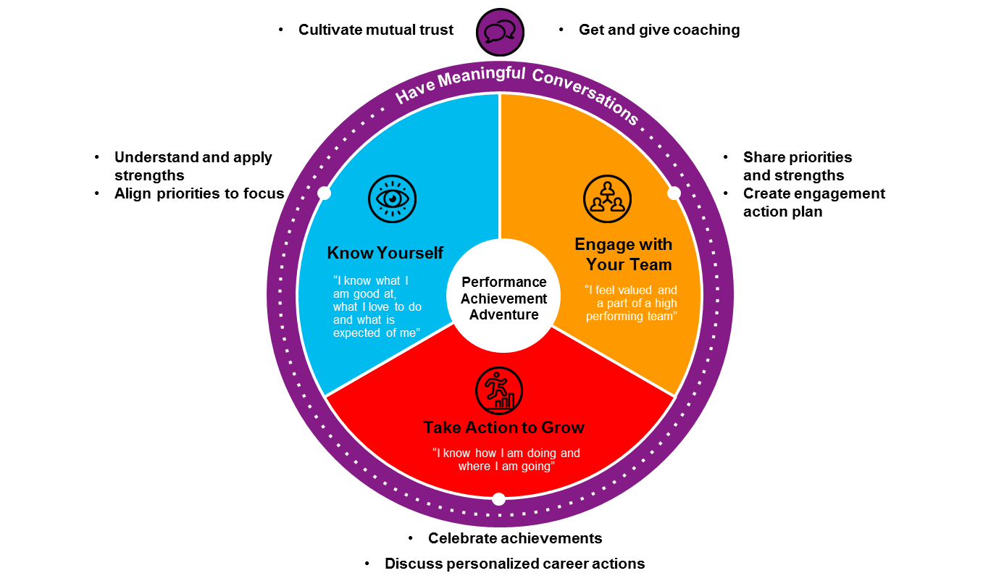
Performance Achievement Overview
Notes:
We want to bring the “achievement” to center stage, and put the “management” back stage.
Know yourself - our strengths and priorities. An employee must be able to say “I know what I am good at, what I love to do and what is expected of me”. To know our strengths and priorities we will:
Use simple tools to understand our strengths and know what we are good at. Focusing on strengths lifts everyone up.
Articulate aspirations and interests. We know that we achieve our highest performance when we work in an area of strength that is aligned to our interest and aspiration. We will have technology that is “all about me” that enables easy and social ways to share our aspirations and create our brand.
Understand expectations, discuss priorities and revisit those priorities frequently. We know from our research that to achieve high performance you must know what is expected of you and be focused on how you will make an impact.
Mention that Strengths Finder is required to be taken by SSEs and above but if the ASEs would like to take the test, they may do so.
Engage with your team - An employee must be able to say “I feel valued and a part of a high performing team”. To engage with our teams we will:
Share, discuss and use the strengths and priorities of our team to ensure we are focused on the right things to drive the highest performance of our teams.
Use on-demand tools to understand team engagement – no longer will we do big annual surveys – rather team leads will be able to understand the engagement of the team anytime using a simple 12 question format oriented to the employee experience.
Determine team based engagement action plans – engagement and performance are driven at the team level – so the team will create the action plan aligned to the core 12 engagement questions.
Take action to grow - An employee must be able to say “I know how I am doing and where I am going”. It is key that we have insight about performance and also about potential (skills, abilities and aspirations) to make the best growth decisions for ourselves, and to take the best talent actions for the business.
We will have new ways to capture and understand insight about performance and will use this information also in new ways.
While we will not have a model where we look back, do peer-to-peer comparisons or label people, we do have a need to understand talent to make thoughtful decisions about our people. We also need to keep the rigor in our process to recognize our highest performers, while also transitioning out those not meeting expectations. To do this, we will now have better insight as we take a holistic view of performance and potential.
We will focus not just on what someone delivered, but also how they develop people, how they grow our business and how they uphold our values. This insight is being captured in a new technology called our personal achievement summary.
We will also understand skills, abilities and aspirations to determine who is progressing, who we continue to invest in for growth, who might be in need of a role change, or who needs to transfer in our out of Accenture.
We will:
Engage in forward looking conversations – the days of looking back to make decisions are over. We now focus forward using the rich insight we will have through new technology that captures a holistic view of a person’s achievements.
Take action to grow skills and capabilities. With a focus on talent actions, we will have better insight on our opportunities for growth and the skills needs we have.
Take accountability for growth and career planning. We need to take our own accountability to use the insight we gain to make a plan for ourselves for the future. This will be supported by easy to use, mobility enabled technology and a new focus on career conversations that look forward and are action oriented.
Meaningful conversations – All of these things will be brought to life through meaningful conversations. An employee must be able to say “I feel supported and am motivated to help others”. We will:
Receive strengths-based, real time coaching on our performance. This is where the heart of our behavioral change and skill building will need to come. Yes we can build tools and technology to support this – but this is about culture, about role-modeling – about feeling the value of true people development.
Build trust-based relationships. Through the focus on the individual and the team, without the pressure of an end of year peer-to-peer comparison, we have a real opportunity to get to know each other as people and create trust-based environment where coaching can be comfortable.
Recognize and celebrate achievements. We know from research and our own experience that positive work environments create the best place to achieve the highest performance.
This is the performance achievement adventure!

Slide 13
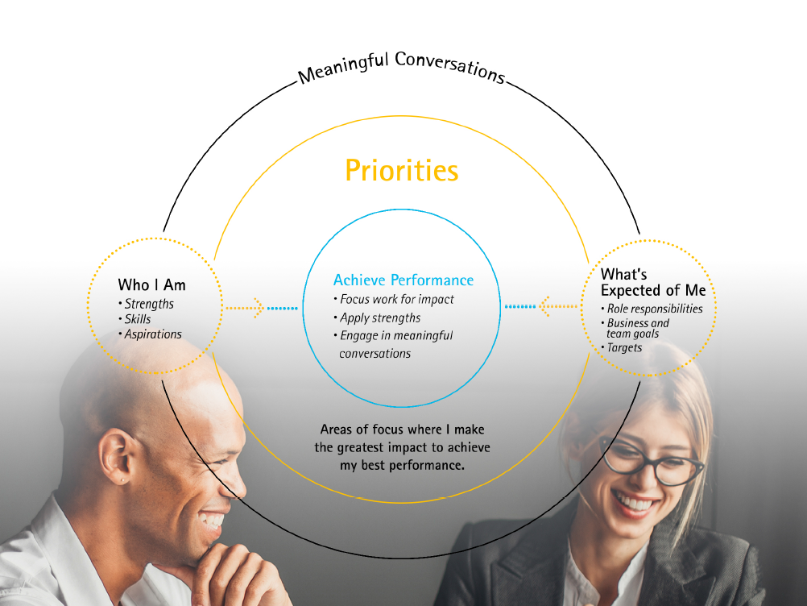
Notes:
To achieve our best performance, we need to know what is expected of us, apply our strengths in the best way to meet those expectations, and have ongoing conversations about how we’re doing. From the clarity of knowing what’s expected of us, we then focus on what’s most important to make the greatest impact for ourselves and for the business. This is what setting priorities is all about.
Priorities can be anything that needs to be top of mind, including things related to my role or my own development, and they help organize our thinking and where we spend our energy.
To determine our own priorities, first we need to understand what our business or team needs us accomplish to be successful. Then we consider our own strengths and aspirations for ourselves. With all of this in mind, we determine a small and manageable set of priorities – typically between 3-5 – that reflect our current focus, but that evolve as expectations change or as we change roles or projects. These priorities are dynamic and reflect the natural changes in our work. They are also the basis upon which we get input/feedback about how we are doing from our team members, supervisors and career counselors.
Sharing priorities through ongoing conversation with each other brings even more clarity. This helps us make connections with each other to understand how our work comes together and how we can help each other in achieving broader goals.
One question you might ask is how my specific metrics for my role play into all of this? Many roles have specific expectations or metrics that need to be met – like a sales target or a quality metric. These are part of your expectations that help set context for defining your priorities. If you have metrics associated with your role, you should have received those from your business or project lead, and later this fiscal year they will be able to be captured in a new tool.
There is a new site that supports capturing and revisiting priorities in a simple way that is available now for early adopters of Performance Achievement and for Managing Directors and will be ready for all of Accenture in January. While the tool will help support you, remember to keep the conversation going – regularly talking about your priorities and how you’re making progress is key to driving performance.

Slide 14
PRIORITIES
how are they used…
Ongoing Conversations
(supported by a tool)
When I mark a priority complete
Used to focus you on the right things for the greatest impact
I reflect how I did
What I’m most proud of
What I’ll take away from the experience
Actions I’ll take to improve or grow further
People who had a significant impact in helping me achieve my priority
Priorities
My reviewer comments on
The impact I made
How I used my skills and strengths
What I can do to continue to grow
Used to highlight how you will make your talent actions happen
Used to drive performance conversations
Notes:
How will priorities be used?
On the previous slide we shared that priorities will be used to focus you on the right things to make the greatest impact.
They will also be used to highlight your talent actions that need to be a priority. For example, if I have a talent action to expand my leadership presence, I would make that a priority to give it the necessary attention and the structure to associate it with a completion date to ensure I make progress against it.
Priorities will also drive performance conversations:
By providing a framework for discussing how progress is being made against priorities
When a priority is completed, there will be a simple way that the individual can reflect how they did against the priority (see questions on slide) and then the reviewer of the priority can comment with their view of how the individual did. This feedback about how a priority was achieved (or not, in some cases) will be an input to talent discussions where there will be recommended next steps for the individual to continue to grow.

Slide 15
Video
Inside Performance Achievement: Strengths and Priorities
Notes:
Go to: https://connectedlearning.accenture.com/learningboard/23832-performance-achievement-know-yourself-learning-board
Play Board 5: Inside Performance Achievement: Strengths and Priorities

Slide 16
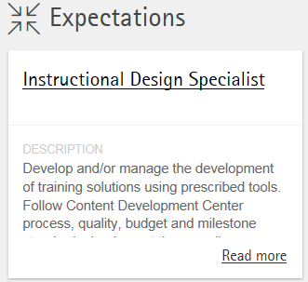
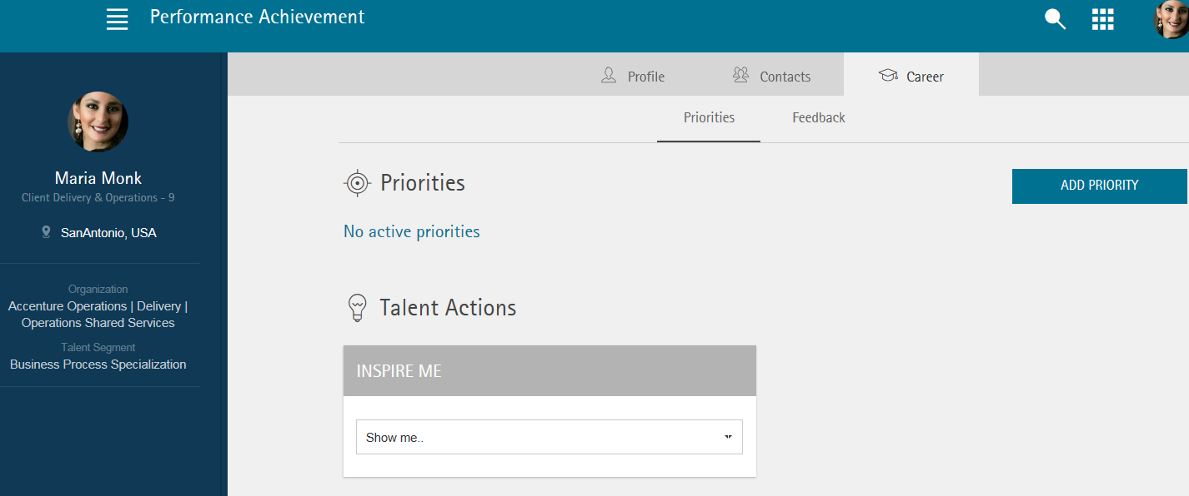
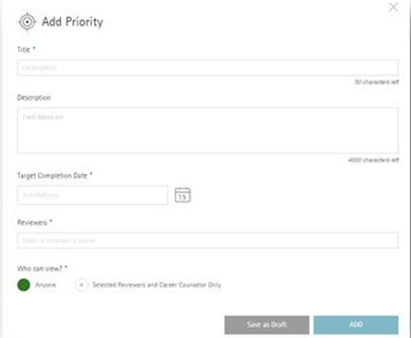

Using the New Tool
Priorities are defined in the new Performance Achievement Tool
Click on the Career tab
Review Expectations
Add a Priority
2
1
3
It’s all about
Notes:
Priorities are defined in the new Performance Achievement Tool
The three inputs for setting our priorities are: Role expectations, business needs, and individual aspirations.
To determine our own priorities, first we need to understand what our business needs us to accomplish to be successful as an organization. This includes role expectations and business goals and targets.
Role Expectations: What are your responsibilities and what specific metrics need to be met, like a sales target or a quality metric, need to deliver x number of training sessions or improve retention rate by 10%? These are part of your expectations that help set context for defining your priorities.
Team and Business Needs: This also includes our team and business goals and targets. Each business defines its goals and targets for the year ahead.
Leadership uses that context, in addition to the context of their role, to define their individual priorities and targets that will help achieve those overall business goals and targets.
We all then look to our leaders’ priorities to understand how our work and priorities connect to the bigger picture.
This type of information will be available in the tool so you can keep in mind what these broader expectations are and consider them when developing your priorities.
Keep in mind that your priorities are not expected to match up directly with the business goals. All of the goals may not be relevant to you, or you may choose to focus on some over others. The key point is thinking about how the work you are doing and the priorities you are setting are contributing to the overall business goals.
In the end, priorities are used to focus our energy and work for impact which will maximize our own performance, and ultimately, drive overall business performance.
Aspirations:
Our aspirations (and also our strengths) help us determine how we are going to deliver on our priorities.
As we consider the specific expectations of our roles, we reflect on how we can deliver those expectations in ways that use our strengths and develop ourselves further to advance us closer to our longer-term aspirations.
As we define our priorities, we consider what we aspire to do and/or achieve in the future, and how we plan to invest in our strengths to bring the best of ourselves to our work.
For instance:
Is there a new responsibility you are eager to take on, or is a promotion in your sights? What skills do you need to build or connections do you need to make to get there?
Is there a different role you are aspiring to? Are you interested in a cross-border assignment or working on a particular team?
Are you looking to become known as an expert in a certain tool, industry or process?
Do you want to increase your name recognition and exposure to leadership?
Do you want to get some sort of industry certification, win an industry award, or be published?
Are you looking to get more involved in a certain area, like knowledge sharing, people development, or mentoring?

Slide 17
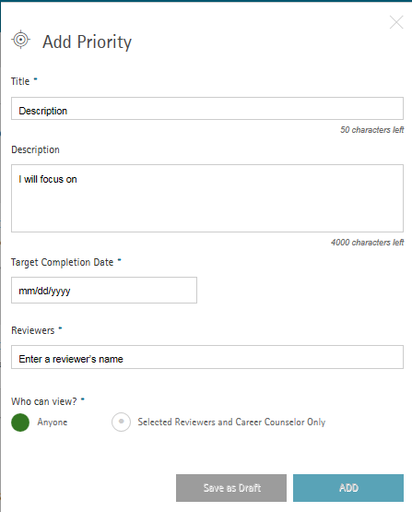
PRIORITIES
think about your own…
Think about what you need to prioritize for your work or development
Take a few minutes to capture your priorities at performance.accenture.com *
Discuss your priorities with your supervisor, teammate or career counselor to confirm you’re focused on the right things and understand how your work is connected to others
Notes:
> During this time, the instructor should be able to do the following:
o Give a quick tour of the actual Performance Achievement site.
o Show his own priorities page to give the participants an example of how it should look like.
o Teach the participants how to add a priority. At this point, the instructors may show the top 3 priorities drafted for their level and status, use them as examples.
o Remind the participants that they are not limited to the top 3 priorities, they may add as they wish.

Slide 18
Priorities while attending Bootcamp or in Center Bench
Title | Description
Complete Preliminary Bootcamp | Successfully complete preliminary bootcamp by ensuring all requirements are met or exceeded such as but not limited to: attendance, class participation, individual or group activities, quizzes, take home assignment, case studies, and examination as the training requires.
Complete New IT trainings | Keep abreast with and be conversant about emerging technologies by completing New IT learning materials available in https://newit.accenture.com/ and passing New IT trainings/ bootcamps recommended by CSET/ Bench Leads.
Personal Deployment Plan | Utilize time in Bench to learn and employ new skills which may or may not be aligned with current skill but are relevant to the business requirements and available demands, in order to increase deployment opportunities within or outside Tech workgroup. Expected outcome may include but not is limited to attending and passing all recommended bootcamp (classroom or online), adapting skills and participating in activities relating to New IT, as well as participating in chargeable activities i.e. Talent Source among others.
Meet Chargeability/ Recovery target | Ensure key targets for Bench are met by leveraging on deployment opportunities within or outside Tech workgroup, such that stay in Bench will be not greater than 3 months at any given time. Activity may include but is not limited to updating of CV, attending and passing project interviews, and accepting available deployment opportunities.
Note:
PRIORITY: New joiners are to set their priorities on the first week of employment, and align as needed whenever they get deployed to a project. Proactively seek discussion with your lead to better understand role expectations, team targets, and business goals.
Samples above are specific to initial bootcamp and Center Bench, reflecting team and business targets and how these translate to individual priority
Initial bootcamp, as well as succeeding bootcamps/ trainings within probationary period, will be one of the major bases for regularization decision
Notes:
Here is a slide showing some of the key priorities/ targets in Bench, where employees are expected to contribute as individuals by exhausting all possible means to be more deployable to projects.
For those in bootcamp, passing the initial and all subsequent trainings will be one of the major bases for regularization decision. Other considerations during probationary employee while in Bench are behavior as well as productivity, and project performance once deployed.
Target Completion
Preliminary Bootcamp
– inputting in the site (Day 1 to Day 3 max)

Slide 19
Resources
Performance Achievement: Know Yourself Learning Board
Key resources here include:
Know Yourself Web based Training
Priorities Guide
Notes:
Summary (30 seconds)
Notes to faculty
Highlight some of the resources available. Explain that the Know Yourself Learning Board should be the main resource for anyone looking for information, encourage participants to go there. You may share the link below for employees to navigate the site at their own pace.
https://connectedlearning.accenture.com/learningboard/23832-performance-achievement-know-yourself-learning-board

